Slide 1
Merkel Cell Carcinoma Collaboration with Cathy Wu and James DeCaprio
Keegan Korthauer
Rafa Lab Meeting
15 February 2019

Slide 2
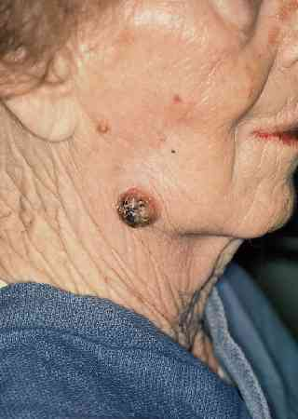
Merkel cell carcinoma (MCC)
Rare and highly aggressive neuroendocrine skin cancer
Two disparate etiologies with similar treatment response rates
60-80% are viral mediated (Merkel Cell Polyomavirus)
Remaining are due to mutations due to Sun/UV exposure
Hypothesized that MCC tumors hide from the immune system due to antigen presentation defects
Notes:
Viral mediated tumor theoretically should have viral antigens that are foreign to immune system.
UV mediated version have high neoantigen load.

Slide 3
Big Picture Questions
Can we predict candidate immune targets from virus positive and virus negative MCC?
Can we learn the mechanisms by which the virus mediates escape of immunosurveillance?
Can we identify genomic correlates to clinical response?
Can we use patient-derived cell lines to answer these questions?

Slide 4
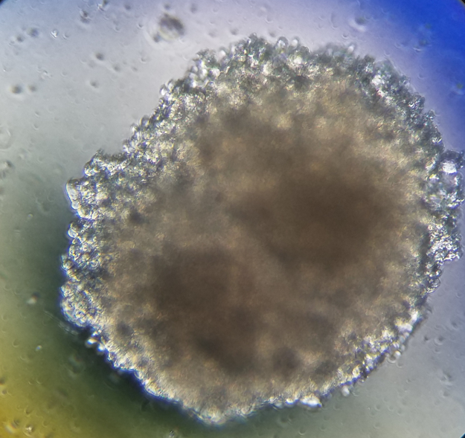
Patient-derived cell lines from tumor samples
Patient-derived tumor cell lines would enable characterization, experimentation, and personalized medicine
Generated 12 lines so far from fresh tumor biopsy material
According to oncopanel markers, cell lines are faithful
Multi-omic data generation in progress:
RNA-seq
WES & WGS
WGBS
ATAC-seq
Mass spec-based histone profiling
Proteomics & Phospho-proteome
HLA-typing

Slide 5
Last time: Cell lines are faithful to tumors based on RNA-seq
Notes:
Using only 1000 HVGs, 286 is still an outlier, but also 350 looks different than other samples as well. Note that 350 is virus negative but all others are virus pos. Here it looks like 286 is clustering with the virus positive samples a bit more.
PCA - loadings make sure not a couple of genes

Slide 6
Big Picture Questions
Can we predict candidate immune targets from virus positive and virus negative MCC?
Can we learn the mechanisms by which the virus mediates escape of immunosurveillance?
Can we identify genomic correlates to clinical response?
RNA-Seq
WGBS
Can we use patient-derived cell lines to answer these questions?
RNA-Seq
WES

Slide 7
WES data received so far
MCC ID | Sample Type | Viral Status
277 | Tumor | +
 | Cell Line
314 | Tumor | +
 | Cell Line
310 | Tumor | +
 | Cell Line

Slide 8
Somatic mutations in tumors vs cell lines
310-T
277-T
314-T
277-C
314-C
310-C

Slide 9
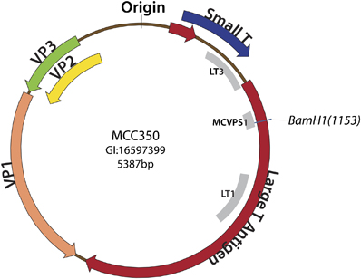
Expression of MCC polyomavirus in virus + tumors/cell lines
MCC PyV Genome
Duncavage et al., 2009 (Modern Pathology)
Notes:
Knockdown of viral T-antigen proteins has been shown to inhibit tumor growth (no effect on viral negative)
T-antigens are oncoproteins that target tumor suppressor genes

Slide 10
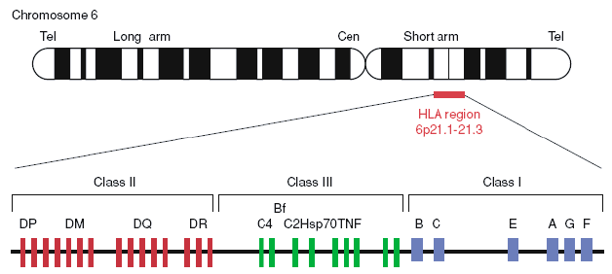
HLA (Human Leukocyte Antigen) locus
Expresses cell surface molecules for presenting antigens to T-cell receptors
6 major Class I alleles
(each with thousands of documented variations)
Notes:
HLA locus is among the most polymorphic regions of the genome
Also called MHC (major histocompatibility complex)
Thousands of documented alleles per gene
Each individual expresses 6 Major class I alleles encoded by 3 genes (HLA-A, HLA-B, and HLA-C)
Important component of the immune system
It encodes cell surface molecules specialized to present antigenic peptides to the T-cell receptor (TCR) on T cells.

Slide 11
Large regions of HLA locus hypomethylated in viral - samples
WGBS in HLA locus (Chromosome 6p21)
Virus +
Virus -
Notes:
HLA locus is among the most polymorphic regions of the genome – thousands of documented alleles / gene.
Each individual expresses 6 major class I alleles encoded by three genes (HLA-A, HLA-B, HLA-C)

